Slide 1
Cheese Making
Student’s name
Institution
Date

Slide 2
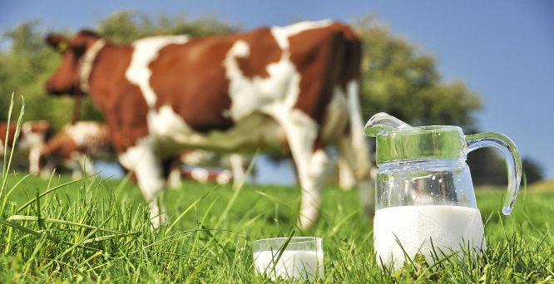
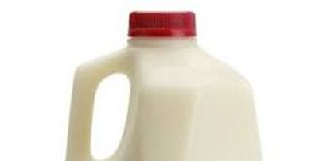
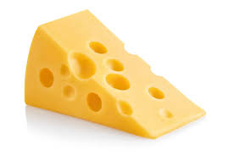
Executive summary
Executive Summary
There exist various varieties of cheese predominantly determined by the ingredients used, processing involved as well as the characteristics of the cheese.
The Standard of Identity in the U.S. Code of Federal Regulation (CFR) is responsible the composition of numerous cheeses.
The main ingredient of production of Cheese is the pasteurized or raw milk.
Raw milk is obtained directly from milking cows illustrated in Figure 1.
The pasteurized milk entails a raw milk that has been heated to a particular temperature as well as duration to eliminate pathogens likely to be found in raw milk.
The law requires all milk sold to the general public to be pasteurized as well as packaged in a licensed dairy plant.

Slide 3
Ingredients
Cheese production uses milk as the main ingredient.
The milk is obtained from cows, goats, sheep, water buffalo and a blend of these milk.
The nature of coagulant used is depended on the type of the cheese wanted.
The acid cheese uses an acid source such as acetic acid found in vinegar or gluconodelta-lactone which is a mild food acid.
The rennet cheeses, calf rennet is produced using microbial bioprocessing.
Calcium chloride may be adopted to improve the coagulation properties of the milk.
Numerous flavorings are added but highly depends on cheese.
other common ingredients are herbs, spices, hot and sweet peppers, horseradish and port wine.

Slide 4
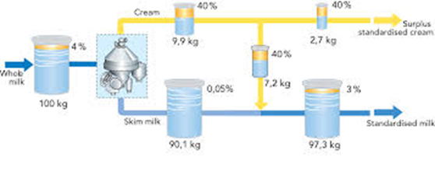
Cheese Making process
According to Johnson (2016) the following procedures is adopted to produce cheese.
Step 1: Standardize Milk
This is the initial stage of cheese production where milk is standardized prior to cheese making. The main objective is to optimize the fat ratio to make excellent quality cheese consisting of high yield (Johnson, 2016).
This is undertaken through methods such as;
  1. Add concentrated non-fat milk solids to the intended milk
  2. Add skim milk to the milk
  3. Remove the cream from the milk.

Slide 5
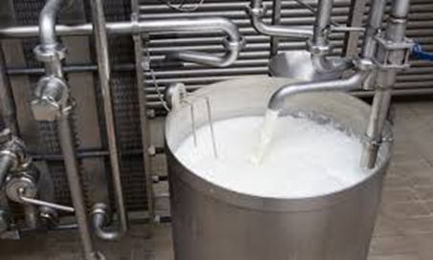
Pasteurize/Heat Treat Milk
Step 2: Pasteurize/Heat Treat Milk
At this stage milk is pasteurized or mild heat treatment with objective to reduce the number of spoilage microorganisms. It can also better the environment for the starter culture’s growth.
However, this stage may be skipped depending on the variety of the cheese required. However, the raw cheese should not be consumed until after 60 days to minimize exposure to microorganisms found in milk that cause diseases.

Slide 6
Cool milk, Inoculate and form curd
Step 3: Cool Milk
When the milk is pasteurized and heated at 32 ℃, it should be allowed to cool to desired temperatures that allow the growth of the starter bacteria. In the event raw milk is utilized in the process, it should be heated to 32 ℃.
Step 4: Inoculate with Starter & Non-Starter Bacteria and Ripen
The starter cultures as well as any non-starter adjunct should be added to the milk while maintaining a temperature of 32 ℃ for at least 30 minutes to allow for ripening. Ripening step permits the growth of the bacteria as well as the fermentation process kicks in. The fermentation lowers the PH as well as a cheese’s flavor develops (Saiki et al. 2018).
Step 5: Add Rennet and Form Curd
The enzyme rennet is added to act on the milk proteins and produce the curd. It is allowed for 30 minutes undisturbed until a firm coagulum is formed.
This stage involves carbon dioxide dissolving in water hence triggering a chemical reaction to create a carbonic acid. The environmental conditions of the milk are usually changed to permit the chemical reaction to occur.
The chemical reaction results in the milk being separated into two specific items the curds(solid) as well as whey (liquid). If the curds are not produced a good cheese cannot be obtained.

Slide 7
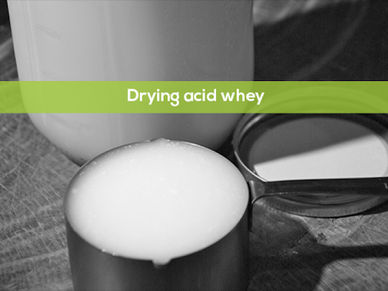
Cut Curd and Dry whey
Step 6: Cut Curd and Heat
At this step, curd is allowed to ferment to a PH value of 6.4. after that, the curd is cut using cheese knives to smaller pieces as well as heated to 38 ℃. The heating is required to separate the whey from curd.
Step 7: Drain Whey
After that the whey is dried from the vat as well as the curd forms a mat.

Slide 8
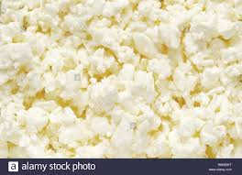
Step 8: Texture Curd
Step 8: Texture Curd
Then cut the curd mats into several sections as well as piled to the top of each respective curd while flipping them periodically a process refereed to as cheddaring.
The cheddaring process is necessary because it assists to expel more whey, while allowing the fermentation to continue until a PH of 5.1 to 5.5 is attained as well as permits the mats to knit together hence forming a matted structured,
Thereafter, the curd mats are then cut into even smaller pieces.

Slide 9
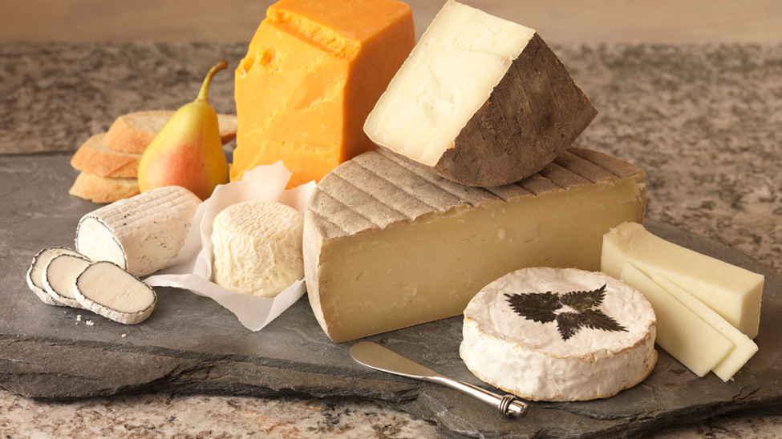
Brine, Blocks, storage and package
Step 9: Dry Salt or Brine
At this step, the cheddar cheese, the smaller, milled curd pieces are placed into the var and salting through sprinkling dry salt on the curd as well as mixing in the salt.
Some cheese variety including mozzarella, the curd is formed into the loaves and the loaves placed into brine which is a solution consisting water and salt.
Step 10: Form Cheese into Blocks
This step involves the salted curd pieces put in cheese hoops then pressed into blocks that allow for the formation of the cheese.
Step 11: Store and Age
The cheese produced is stored in coolers to the point when the needed age is attained. The cheese is aged for some months extending to years.
The storage of cheese can be done using methods such as;
Using a resealable plastic bag though it is not recommended storage solution for the cheese
Regardless of the nature of the cheese, stash it in the vegetable crisper of the refrigerator where temperatures are very cold as well as stable
Using a piece of plastic wrap and a wax paper, rewrap the cheese after every single use
Fresh cheese in water such as mozzarella or feta are usually left in the original ckaging while ensuring that water is constantly changed.

Slide 10

Package and uses of cheese
Step 12: Package
The cheese can also be cut as well as packaged to blocks and also waxed depending on the preference.
The figure below shows how cheese can package in various forms ready for retailing and consumption.

Slide 11
Uses of cheese
According to Barbosa et al. (2020) cheese is used for various uses listed as follows;
  Prevent Osteoporosis
  Create a positive effect on an individual’s dental health.
  Assist people gain weight in a healthy way
  Best dietary source for calcium
  Excellent source of protein
  Contains a lot of vitamin B12
  It is ideal for high blood pressure patients to reverse hypertension
  Offers the required fat
  Can also prevent some of the common cancers
  It is plentiful in healthy fats
  It’s a good choice for pregnant women
  It assists people in the muscle building
  It can also boost the individual’s immune systems
  Provides vitamin K2
  It is good for the Thyroid Health.

Slide 12
References
Barbosa, C. H., Andrade, M. A., Vilarinho, F., Castanheira, I., Fernando, A. L., Loizzo, M. R., & Silva, A. S. (2020). A New Insight on Cardoon: Exploring New Uses besides Cheese Making with a View to Zero Waste. Foods, 9(5), 564.
Johnson, M. E. (2016). Cheese: Preparation of Cheese Milk.
Saiki, R., Hagi, T., Narita, T., Kobayashi, M., Sasaki, K., Asahina, Y., ... & Nomura, M. (2018). Effects of the addition of non-starter lactic acid bacteria on free amino acid production during cheese ripening. Food Science and Technology Research, 24(2), 299-309.

Slide 13
Thank you
Presentation by (your name)

